Slide 1
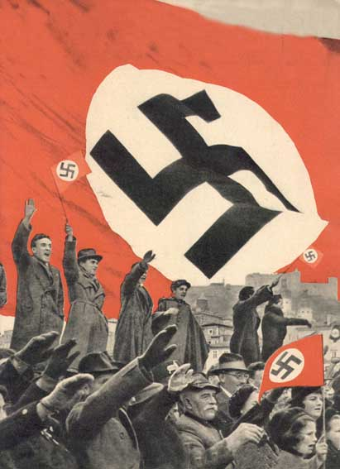
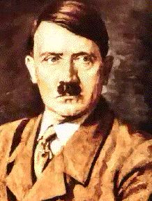
How did Hitler turn the German Chancellorship into a dictatorship by 1934?

Slide 2

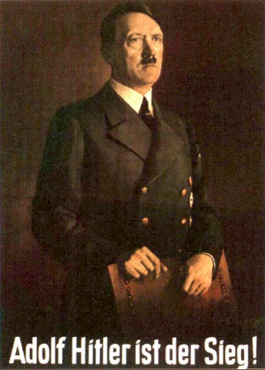
Hitler
became
Chancellor
The
Reichstag
Fire
The
Enabling
Act
Der Fuhrer
Oath of
loyalty
to
Hitler
Death of
President
Hindenburg
Night
of the
Long
Knives

Slide 3
The 1930s Great Depression had a significant and demoralizing impact on Germany.
During the election campaign, Hitler promised to (1) create jobs and (2) rebuild German pride. Many Germans voted for Hitler, but Hitler did not win a majority. To govern, a coalition between the different political parties was formed.
In January 1933, Von Papen convinced German President Hindenburg that Hitler should become Chancellor of Germany. Almost immediately, Hitler dissolved Parliament and called for a new March 1933 election.
Hitler became
Chancellor

Slide 4
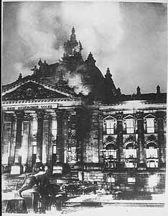
The Reichstag Fire
In February 1933 and six days before the election, the German parliament building, the Reichstag, burned.
A Communist was found inside the building. He admitted to starting the fire.
Chancellor Hitler convinced the German people that the Communists were terrorists who were trying to take control of the government and Germany.
Hitler convinced the German President to pass an emergency decree to fight the terrorists. Under the decree, (1) civil rights were suspended, (2) 4,000 members of the KPD were arrested and (3) Communists were banned from the Reichstag. Why would Hitler use the decree to suspend rights and ban Communists from the German House of Parliament?

Slide 5
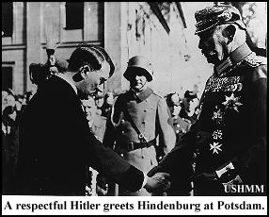
The Enabling Act
With the Communists banned from the Reichstag, Hitler won the March 1933 election…but without a clear and significant majority.
To gain power, Hitler enacted the Enabling Act. Under the Act, Hitler could rule Germany for four years without having to consult and seek approval from the elected members of the Reichstag. How would the Enabling Act help Hitler?

Slide 6
The Enabling Act gave Hitler the power to make his own laws…and effectively ignore or change Germany’s Constitution.
One of his first actions was to either ban or minimize the influence of other political parties including the Social Democrats (SPD), Communists (KPD), German Democrats (DDP) and the German Centre Party (Zentrum).
Why would Hitler want to take this step?
SPD
KPD
Zentrum
DDP

Slide 7
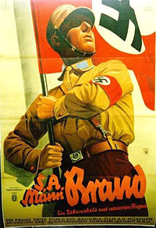
The Night of the Long Knives
Ernst Rohm was a friend and political colleague of Hitler, and a co-founder of the paramilitary Nazi Sturmabteilung (SA – Brownshirts). Using violence and intimidation, the SA helped Hitler rise to power. In return, Rohm wanted the SA to replace the German army.
Rohm was too much of a political threat.
On 30 June 1934, Hitler’s SS and the Gestapo killed 85 SA political leaders including Rohm and jailed thousands of SA troops and supporters. The event is called the Night of the Long Knives.
Over the next few days, Hitler also attacked and killed his other political opponents…to protect the state.
The army were pleased. Hitler had gained the support of the army.

Slide 8
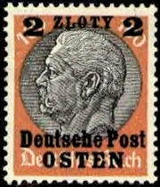
Death of German President Hindenburg
On 2 August 1934, German President Hindenburg died.
The death allowed Hitler to combine the role of Chancellor and President. He called himself ‘Der Fuhrer’.
With 90% approval from the German people, Hitler abolished the German Presidency.

Slide 9
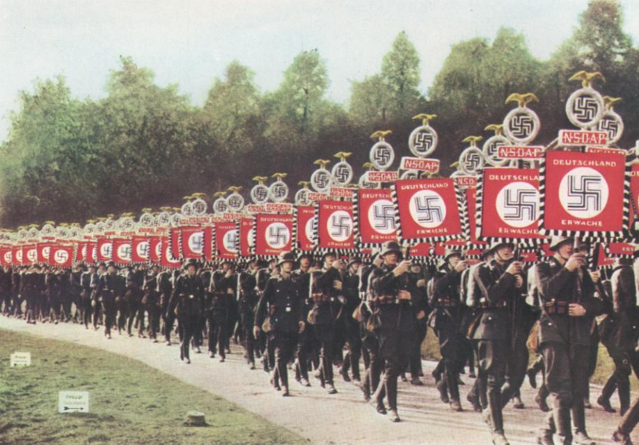
Oath of loyalty
to Adolf Hitler
Every soldier swore a personal oath of loyalty to Adolf Hitler. Hitler had complete control of Germany.

Slide 10
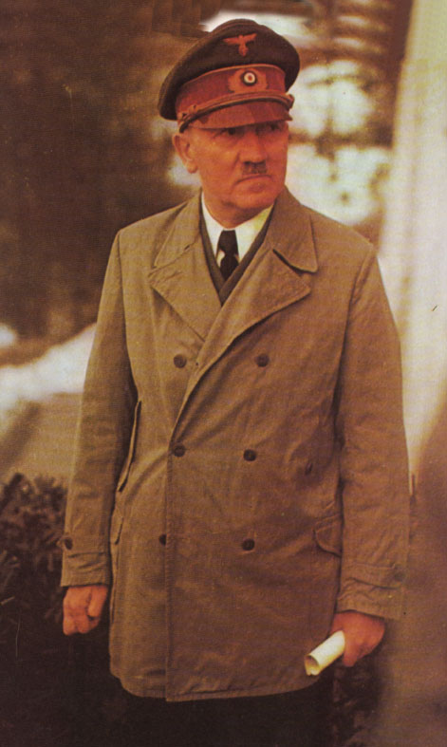
So, how did he become
a dictator legally?

Slide 11
Hitler
became
Chancellor
The
Reichstag
Fire
The
Enabling
Act
Der Fuhrer
Oath of
loyalty
to
Hitler
Death of
President
Hindenburg
Night
of the
Long
Knives

